Slide 1
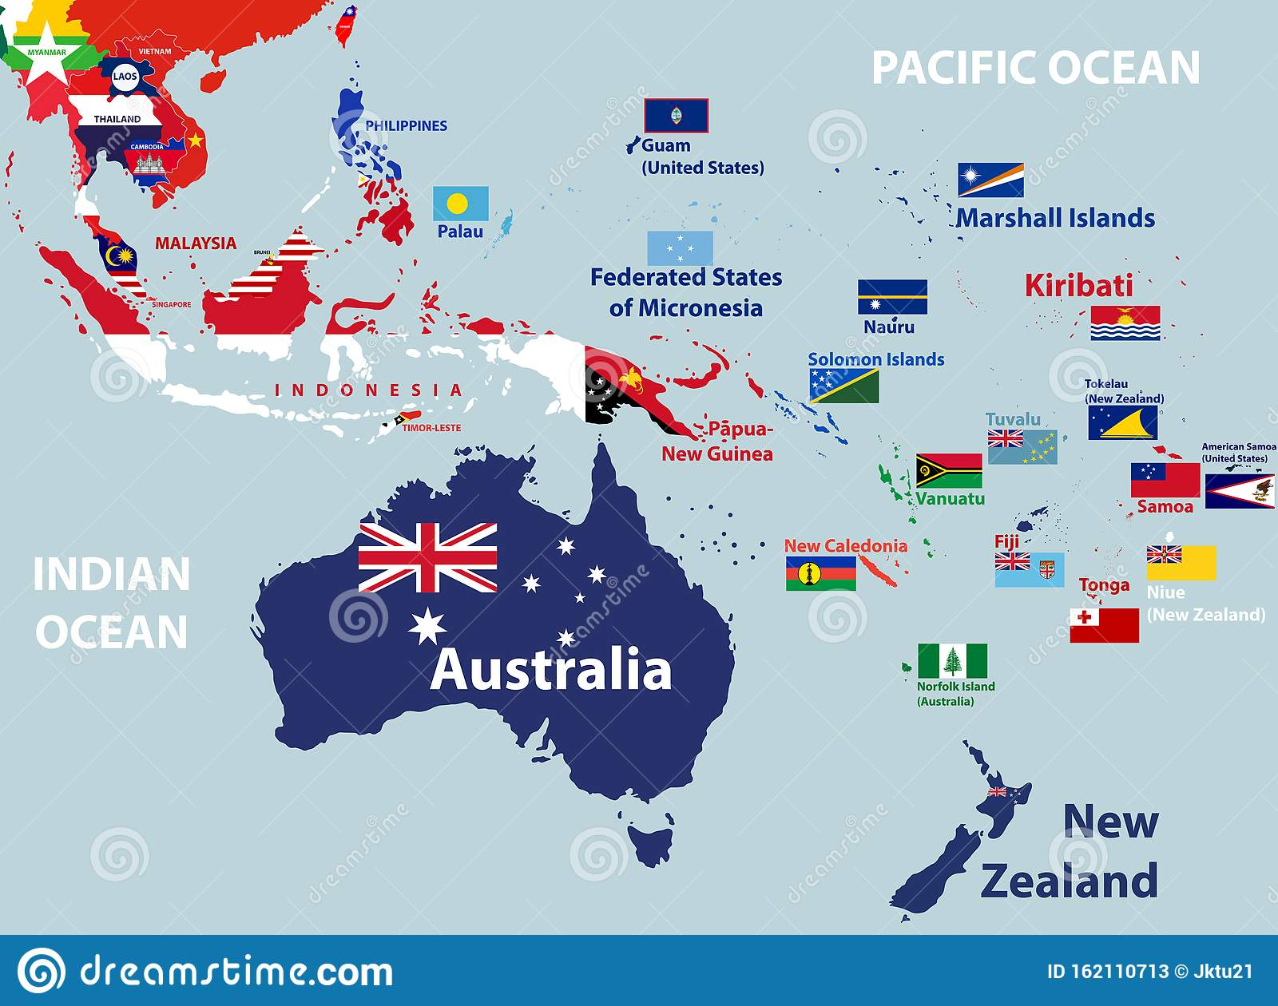
Інтеграційні процеси та об’єднання Австралії та Океанії

Slide 2
8,525,989 кв.км
41 млн чол
Як високо розвинені економіки з високим рівнем життя та індексом людського розвитку: Австралія, Нова Зеландія, Нова Каледонія, Фр.Полінезія та Гаваї
Мало розвинені: Папуа Нова Гвінея, Індонезійська Нова Гвінея, Вануату, Кірібаті, Тувалу
Фіджі, Палау ,Тонга - середньорозвиненя

Slide 3
Чинники розвитку процесів співробітництва
Об’єктивні причини – острівні території
Диспропорції розвитку
Іноземна присутність, вплив
Залежність від кліматичних змін, несприятливі умови для СГ та виробництва
Низька заселеність, відносно пізня урбанізація 1970+, однак зараз більшість ТО держав мають високу щільність населення у містах (окрім Папуа НГ)
Низький виробничий потенціал

Slide 4
Політичний розвиток
держави регіону (Австралія, Нова Зеландія)
Володіння інших держав (Франція, Британія, США)
Коралові атоли та острови

Slide 5
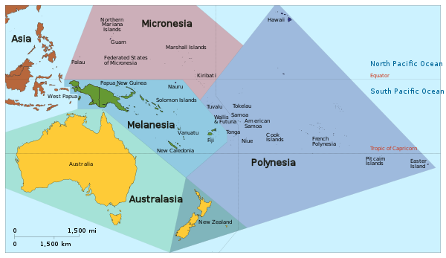
Регіоналізація
Мікронезія,
Мелонезія
Полінезія
Австралазія

Slide 6
Форми співробітництва
Міжнародні організації
Безпекові альянси низького рівня інституціоналізації
Інтеграційні утворення фінансово-монетарного характеру
Допомога Австралії та Нової Зеландії країнам регіону
Pacific Islands Forum Secretariat (PIFS) $24.96 million in core contributions, 2018-2021
Pacific Community (SPC) $42.5 million in core contributions, 2021-23
Без’ядерна зона

Slide 7
The Pacific Islands Forum (PIF)
is the region's principal political grouping. Established in 1971, its membership comprises Australia, Cook Islands, Federated States of Micronesia, Fiji, French Polynesia, Kiribati, Nauru, New Caledonia, New Zealand, Niue, Palau, Papua New Guinea, Republic of Marshall Islands, Samoa, Solomon Islands, Tonga, Tuvalu, and Vanuatu. Tokelau and Wallis and Futuna are associate members. The Forum's annual Leaders' Retreat is the peak regional political meeting for political discussions on deeper regional cooperation and integration. DFAT also supports Australia’s participation in the annual and ad-hoc Forum Ministerial Meetings. Forum members are serviced by a Secretariat based in Suva, Fiji. In 2020, Australia contributed approximately 32% of the budget for the PIF Secretariat. See the Pacific Regional – effective regional institutions page for further information about Australia’s support to the PIF.

Slide 8
The Pacific Community (SPC)
delivers technical assistance, policy advice, training and research services for the region. The SPC membership comprises American Samoa, Australia, Cook Islands, Federated States of Micronesia, Fiji, France, French Polynesia, Guam, Kiribati, Marshall Islands, Nauru, New Caledonia, New Zealand, Niue, Northern Mariana Islands, Palau, Papua New Guinea, Pitcairn Islands, Samoa, Solomon Islands, Tokelau, Tonga, Tuvalu, United States of America, Vanuatu, and Wallis and Futuna. Its programs span a number of sectors addressing sustainable economic development, natural resource and environmental management, and human and social development. In 2020, Australia contributed approximately 28.5% of the SPC budget. See the Pacific Regional – effective regional institutions page for further information about Australia’s support to SPC.

Slide 9
The Forum Fisheries Agency (FFA)
is an advisory body that assists members to strengthen national capacity and regional solidarity to maximise benefits from the conservation and sustainable use of their tuna fisheries resources. Alongside fisheries management and development assistance, the FFA operates the Regional Fisheries Surveillance Centre which provides a central link for coordinated action against Illegal, Unreported and Unregulated (IUU) fishing. In 2019-20, Australia contributed approximately 16.75% of the FFA budget. See the Pacific Regional – Economic growth: fisheries assistance page for further information on Australia’s support to the FFA and other regional fisheries assistance.

Slide 10
The Secretariat of the Pacific Regional Environment Programme (SPREP)
provides assistance in order to protect and improve the Pacific environment and to ensure sustainable development for present and future generations. For example, SPREP contributes to Pacific engagement on United Nations Framework Convention on Climate Change (UNFCCC) negotiations. Australia provides $4.3 million core funding to SPREP annually, as well as additional program funding. For example, the Pacific Ocean Litter Project ($16 million, 2019-2025) focuses on reducing the sources of single-use plastics in the marine environment. See the Australia and the Pacific: partnering to support sustainable oceans and livelihoods page for further information on Australia’s support to SPREP and other regional environmental protection assistance.

Slide 11
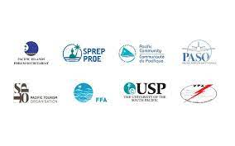
Council of Regional Organizations of the Pacific (CROP).
for further information on Australia’s support to USP and other regional education assistance)
The Pacific Islands Development Program (PIDP), housed in the East-West Center in Hawaii, assists Pacific Islands Leaders to advance their collective efforts to achieve and sustain equitable social and economic development consistent with the goals of the Pacific islands region's people
The South Pacific Tourism Organisation (SPTO), which is the mandated inter-governmental body for the tourism sector in the region, with the mission to market and develop tourism in the South Pacific
The Pacific Power Association (PPA), which promotes the direct cooperation of Pacific island power utilities in technical training, exchange of information, sharing of senior management and engineering expertise and other activities of benefit to the members
The Pacific Aviation Safety Office (PASO) which oversees aviation safety and security in the Pacific Islands using guidelines provided by the International Civil Aviation Organisation (ICAO).

Slide 12
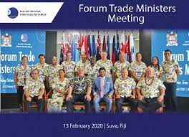
Pacific Islands Forum Ministerial Meetings
In addition to the annual Leaders Retreat, the Pacific Islands Forum convenes a range of other high-level ministerial meetings. There are standing annual meetings of Forum Foreign Ministers and Forum Economic Ministers Meetings. An annual meeting of Pacific Women Leaders will commence in 2021 and Forum Trade Ministers will begin to meet every two years. The Forum also coordinates with other Pacific regional organisations to facilitate high-level government contact.

Slide 13
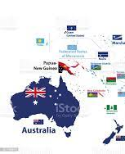
Регіональна архітектура
Частина взаємодії з регіонами АСЕАН, Східної Азії, Індотихооканського простору
Безпекові ініціативи
Особливі відносини Австралія-Нова Зеланідя

Slide 14
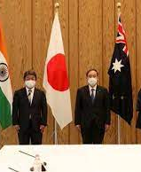
Quad, вересень 2021
Australia's Quad partnership with India, Japan and the United States is a key pillar of our Indo-Pacific agenda. The Quad is a diplomatic network of four countries committed to supporting an open, inclusive and resilient region. It complements our other bilateral, regional and multilateral cooperation, including with ASEAN.
The Quad has a positive, practical agenda to respond to the defining challenges of our time, including COVID-19 vaccines, critical and emerging technology, cyber security, climate change, infrastructure, maritime security, countering disinformation, counter-terrorism, and humanitarian assistance and disaster relief.
The Quad Vaccines Partnership is expanding access to safe and effective COVID-19 vaccines in the Indo-Pacific by boosting supply, sharing vaccine doses, and supporting vaccine rollouts across the region. Australia’s $100 million contribution will focus on vaccine procurement and ‘last-mile’ delivery support to Southeast Asia. For full details of Quad partners’ regional support see the Quad Partnership COVID-19 Dashboard.
Quad partners are steadfast supporters of ASEAN centrality, the ASEAN-led architecture and ASEAN’s Outlook on Indo-Pacific.
The Quad's origins date back to our cooperation in the wake of the December 2004 tsunami, which created an unprecedented humanitarian crisis around the Indian Ocean. At that time, Quad countries coordinated rapid humanitarian assistance and disaster relief.

Slide 15
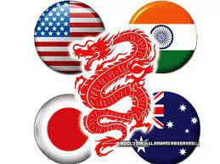
Quad meetings and processes four primary channels – Leaders, Foreign Ministers, Senior Officials, and Experts.
First in-person Quad Leaders' Summit: 24 September 2021
At the Summit, leaders outlined progress, and announced further initiatives, on existing cooperation on COVID-19 vaccines, critical and emerging technology, and combatting climate change. They also launched new Quad cooperation on infrastructure, cyber, the sustainable and stable use of outer space, and cultivating next-generation STEM talent.
Leaders have agreed to meet annually.
Foreign Ministers' Meetings
Quad Leaders’ meetings build on extensive engagement by Quad Foreign Ministers, who have met three times. The last Quad Foreign Ministers’ Meeting was held virtually on 18 February 2021, preceded by meetings in Tokyo in October 2020 and New York in September 2019.
Regular Senior Officials' Meetings
Eight Quad Senior Officials' Meetings have been held since November 2017. At these meetings, officials exchange strategic assessments and progress practical cooperation led by leaders and Foreign Ministers.
Senior Quad experts engage regularly across the breadth of the Quad's practical cooperation agenda.

Slide 16
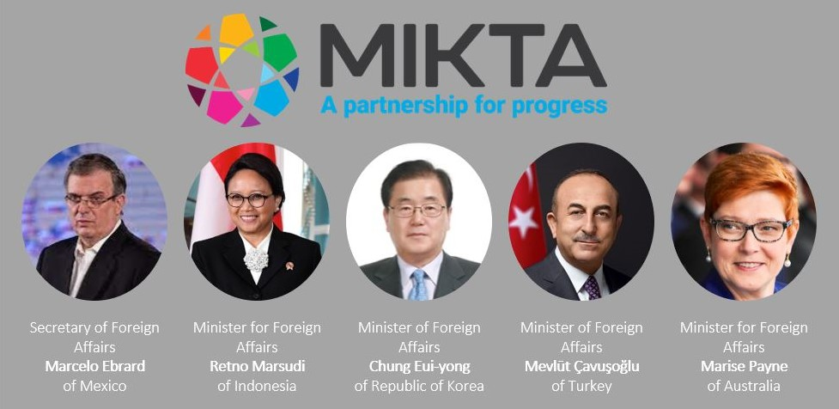
MIKTA – Mexico, Indonesia, the Republic of Korea, Turkey and Australia
MIKTA is a diverse and cross-regional grouping of powers that brings together Mexico, Indonesia, the Republic of Korea (ROK), Turkey and Australia. MIKTA aims to bridge divides in the multilateral system and build consensus on complex and challenging issues, drawing on the diverse perspectives of its members and their shared interest in an effective, rules-based global order.
MIKTA is led by foreign ministers, who first came together at the inaugural MIKTA meeting in September 2013. Since then, our exchanges have grown to encompass collaboration between academics, diplomats, journalists, parliamentarians, and experts. It has focused discussions and statements in areas ranging from trade to cyber, health, gender equality, governance and sustainable development. For example, in April 2020, MIKTA foreign ministers released a statement about the impacts of COVID‑19.

Slide 17
The Australia - New Zealand Closer Economic Relations Trade Agreement
one of the most comprehensive bilateral free trade agreements in existence. It covers substantially all trans-Tasman trade in goods, including agricultural products, and was the first to include free trade in services.
Key interests and benefits
All tariffs and quantitative import or export restrictions on trade in goods originating in the Free Trade Area are prohibited under ANZCERTA.
Contains measures to minimise market distortions in trade in goods, including through domestic industry assistance and export subsidies and incentives.
The harmonisation of Trans-Tasman food standards through the Australia New Zealand Food Authority (ANZFA) Agreement of 1995 means lower compliance costs for industry, fewer regulatory barriers, and more consumer choice.
Mutual recognition of goods and occupations removes technical barriers to trade and impediments to the movement of skilled personnel between jurisdictions without the need for complete harmonisation of standards and professional qualifications.
The Protocol on Investment to ANZCERTA entered into force on 1 March 2013. Under the Protocol investors in both countries benefit from lower compliance costs, higher screening thresholds and greater legal certainty when investing in their Trans-Tasman neighbour.

Slide 18
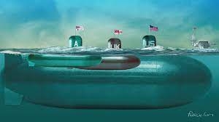
AUKUS
September 2021
Partnership with USA and UK
Uncertainty, global transformation

