Slide 1
Lecture 8.Sectoral Integration. Case: The EU – Ukraine Association Agreement

Slide 2
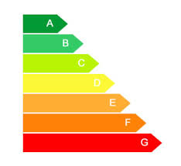
TITLE V ECONOMIC AND SECTOR COOPERATION
CHAPTER 1 ENERGY COOPERATION, INCLUDING NUCLEAR ISSUES
Article 338
Areas of mutual cooperation are listed
Article 341
approximation of legislation Ukraine (timetable in the Annex XXVII) e.g:
Directive 2006/67/EC on maintaining minimum stocks of crude oil and/or petroleum
Directive 2002/91/EC on the energy performance of buildings
Directive 2005/32/EC on establishing a framework for the setting eco-design requirements for energy using products
CHAPTER 2 MACRO-ECONOMIC COOPERATION
…
Article 345
A regular dialogue (also in other areas /sectors)
CHAPTER 3 MANAGEMENT OF PUBLIC FINANCES: BUDGET POLICY, INTERNAL CONTROL AND EXTERNAL AUDIT
Article 347
E.g. development of medium-term budget forecast/planning system
Implementation of international standards (external audit , internal financial control )

Slide 3
CHAPTER 4 TAXATION
Article 351
E.g. cooperation for Value Added Tax (VAT) refund procedures
Article 352
gradual approximation of excise rates on tobacco products …
Article 353
gradual approximation to the taxation structure (Annex XXVIII), the EU legal acts on VAT, travellers' allowances, excise duties (and alcoholic beverages, energy products and electricity, manufactured tobacco )
CHAPTER 5 STATISTICS
Article 355
E.g. gradual approximation of the Ukrainian statistical system
CHAPTER 6 ENVIRONMENT
CHAPTER 7 TRANSPORT
Article 368
gradual approximation towards operating standards and policies described in the Annex [XXXI]
Article 369
E.g. transport projects in Annex [XXXII] - map

Slide 4
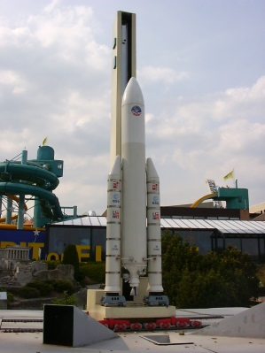
CHAPTER 8 SPACE
CHAPTER 9 COOPERATION IN SCIENCE AND TECHNOLOGY
Стаття 376
E.g. participation in the Framework Programme for Research and Technological Development
CHAPTER 10 INDUSTRIAL AND ENTERPRISE POLICY
Стаття 378
Particular emphasis on Small and Medium Sized Enterprises
CHAPTER 11 MINING AND METALS
CHAPTER 12 FINANCIAL SERVICES
Article 384
cooperation between relevant Regulatory and Supervisory Authorities, including personnel exchange and joint training
Article 385
gradual approximation with recognised international standards on
regulation and supervision

Slide 5
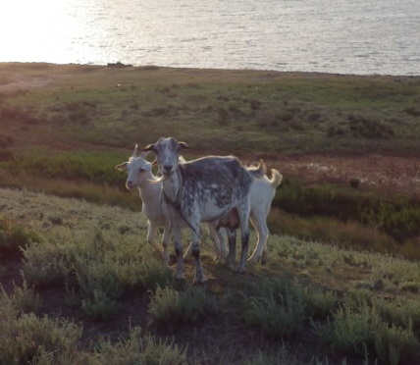
CHAPTER 13 COMPANY LAW, CORPORATE GOVERNANCE, ACCOUNTING AND AUDITING
CHAPTER 14 INFORMATION SOCIETY
Article 390
increased participation of Ukraine in the ICT research activities of the EU
Article 391
E.g. cooperation in development of e-business, e-government, e-health and e-learning
CHAPTER 15 AUDIO-VISUAL POLICY
CHAPTER 16 TOURISM
CHAPTER 17 AGRICULTURE AND RURAL DEVELOPMENT
Article 405
gradual approximation to the EU legislation and regulatory standards – Annex XXXVII:
Quality Policy,
Organic farming,
Genetically modified crops,
Biodiversity,
Marketing standards for plants, seeds of plants, products derived from plants, fruits and vegetables

Slide 6
CHAPTER 18 FISHERIES AND MARITIME POLICY
CHAPTER 19 DANUBE RIVER
CHAPTER 20 CONSUMER PROTECTION
Article 417
gradually approximation of Ukrainian legislation with the EU acquis, Annex XXXVIII – mostly 3 years:
Product Safety
Marketing
Contract Law
Unfair Contract Terms
Doorstep selling
Financial Services
Consumer credit
Redress
Enforcement
Consumer protection cooperation
CHAPTER 21 COOPERATION ON EMPLOYMENT, SOCIAL POLICY AND EQUAL OPPORTUNITIES

Slide 7
CHAPTER 22 PUBLIC HEALTH
CHAPTER 23 EDUCATION, TRAINING, AND YOUTH
CHAPTER 24 CULTURE
CHAPTER 25 COOPERATION IN THE FIELD OF SPORT AND PHYSICAL ACTIVITY
CHAPTER 26 CIVIL SOCIETY COOPERATION
CHAPTER 27 CROSS-BORDER AND REGIONAL COOPERATION
CHAPTER 28 PARTICIPATION IN EUROPEAN UNION AGENCIES AND PROGRAMMES

